Slide 1
Classical Mechanics

Slide 2
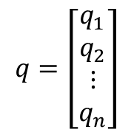
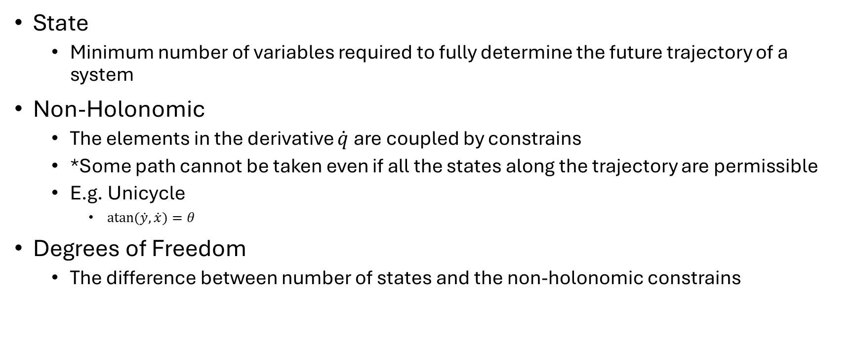
States of a system
State
  Minimum number of variables required to fully determine the future trajectory of a system
Non-Holonomic
  The elements in the derivative $\dot{q}$are coupled by constrains
  *Some path cannot be taken even if all the states along the trajectory are permissible
  E.g. Unicycle
    $atan⁡(\dot{y},\dot{x})=θ$
Degrees of Freedom
  The difference between number of states and the non-holonomic constrains
$$q=\left[\begin{matrix}q_{1} \\ q_{2} \\ ⋮ \\ q_{n}\end{matrix}\right]$$

Slide 3

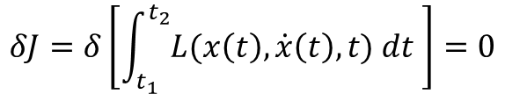
Hamilton’s principle
The Lagrangian of the real trajectory of a system is a local optimum
Euler-Lagrange equation
$$δJ=δ\left[\int_{t_{1}}^{t_{2}}{L(x\left(t\right),\dot{x}\left(t\right), t) dt }\right]=0$$
$$\frac{d}{dt}\frac{∂L}{∂\dot{x_{i}}}−\frac{∂L}{∂x_{i}}=0 ∀i$$

Slide 4
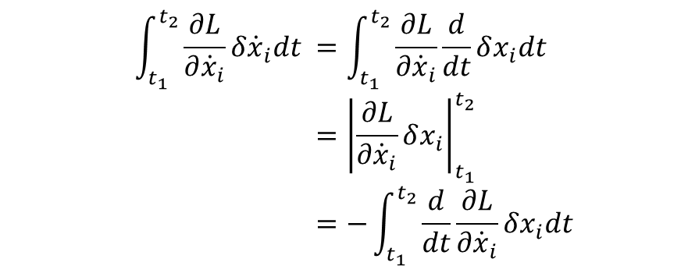
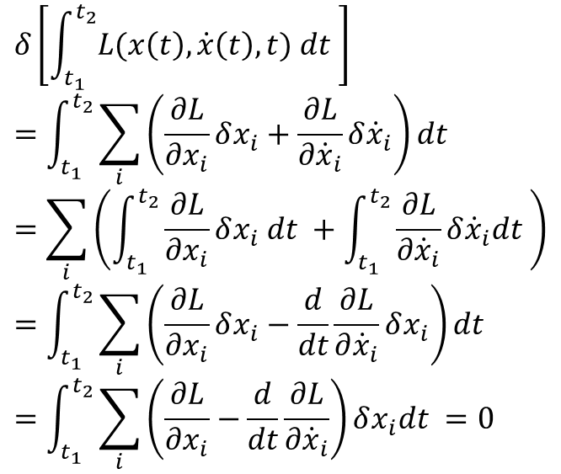

Proof: Euler-Lagrange
$$δ\left[\int_{t_{1}}^{t_{2}}{L(x\left(t\right),\dot{x}\left(t\right), t) dt }\right] \\ =\int_{t_{1}}^{t_{2}}{\sum_{i}{\left(\frac{∂L}{∂x_{i}}δx_{i}+\frac{∂L}{∂{\dot{x}}_{i}}δ{\dot{x}}_{i}\right)}dt } \\ =\sum_{i}{\left(\int_{t_{1}}^{t_{2}}{\frac{∂L}{∂x_{i}}δx_{i} dt }+\int_{t_{1}}^{t_{2}}{\frac{∂L}{∂{\dot{x}}_{i}}δ{\dot{x}}_{i}dt }\right)} \\ =\int_{t_{1}}^{t_{2}}{\sum_{i}{\left(\frac{∂L}{∂x_{i}}δx_{i}−\frac{d}{dt}\frac{∂L}{∂{\dot{x}}_{i}}δx_{i}\right)}dt } \\ =\int_{t_{1}}^{t_{2}}{\sum_{i}{\left(\frac{∂L}{∂x_{i}}−\frac{d}{dt}\frac{∂L}{∂{\dot{x}}_{i}}\right)}δx_{i}dt }=0$$
$$\int_{t_{1}}^{t_{2}}{\frac{∂L}{∂{\dot{x}}_{i}}δ{\dot{x}}_{i}dt }=\int_{t_{1}}^{t_{2}}{\frac{∂L}{∂{\dot{x}}_{i}}\frac{d}{dt}δx_{i}dt } \\ ={\left|\frac{∂L}{∂{\dot{x}}_{i}}δx_{i}\right|}_{t_{1}}^{t_{2}}−\int_{t_{1}}^{t_{2}}{\frac{d}{dt}\frac{∂L}{∂\dot{x}}δx_{i}dt} \\ =−\int_{t_{1}}^{t_{2}}{\frac{d}{dt}\frac{∂L}{∂{\dot{x}}_{i}}δx_{i}dt}$$
By part
No variation at boundary
For this to be true for all possible variations $δx_{i}$
$$\frac{∂L}{∂x_{i}}−\frac{d}{dt}\frac{∂L}{∂\dot{x}}=0 ∀i$$

Slide 5
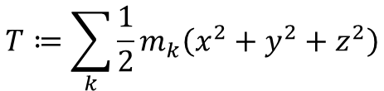

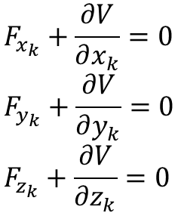
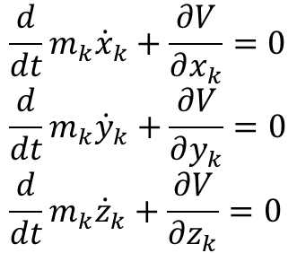

Example : Mechanical System of Particles
$$T≔\sum_{k}{\frac{1}{2}m_{k}\left(x^{2}+y^{2}+z^{2}\right)}$$
$$V≔V(x_{1},y_{1},z_{1} ⋯,x_{k},y_{k},z_{k},⋯,t)$$
$$L=T−V$$
$$\frac{d}{dt}m_{k}{\dot{x}}_{k}+\frac{∂V}{∂x_{k}}=0 \\ \frac{d}{dt}m_{k}{\dot{y}}_{k}+\frac{∂V}{∂y_{k}}=0 \\ \frac{d}{dt}m_{k}{\dot{z}}_{k}+\frac{∂V}{∂z_{k}}=0$$
$$F_{x_{k}}+\frac{∂V}{∂x_{k}}=0 \\ F_{y_{k}}+\frac{∂V}{∂y_{k}}=0 \\ F_{z_{k}}+\frac{∂V}{∂z_{k}}=0$$

Slide 6

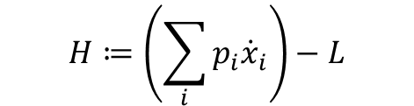
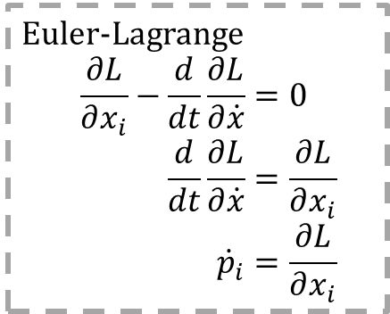



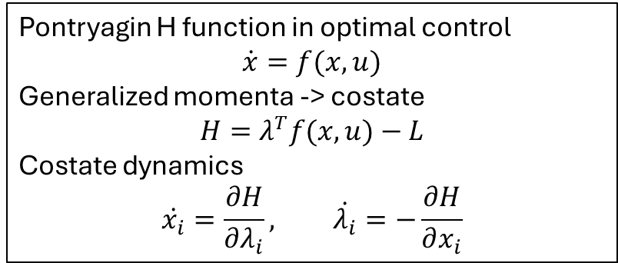

Hamiltonian Function
Pontryagin H function in optimal control
$$\dot{x}=f(x,u)$$
Generalized momenta -> costate
$$H=λ^{T}f(x,u)−L$$
Costate dynamics
$$\dot{x_{i}}=\frac{∂H}{∂λ_{i}}, \dot{λ_{i}}=−\frac{∂H}{∂x_{i}}$$
Generalized momenta
Hamiltonian function
Canonical Form
$$p_{i}≔ \frac{∂L}{∂{\dot{x}}_{i}}$$
$$H≔\left(\sum_{i}{p_{i}{\dot{x}}_{i}}\right)−L$$
Euler-Lagrange
$$\frac{∂L}{∂x_{i}}−\frac{d}{dt}\frac{∂L}{∂\dot{x}}=0 \\ \frac{d}{dt}\frac{∂L}{∂\dot{x}}=\frac{∂L}{∂x_{i}} \\ {\dot{p}}_{i}=\frac{∂L}{∂x_{i}}$$
$$H=V\left(x,u,t\right)+λ^{T}f(x,u)$$
$$\frac{∂H}{∂p_{i}}={\dot{x}}_{i}$$
$$\frac{∂H}{∂x_{i}}=−\frac{∂L}{∂x_{i}}={−\dot{p}}_{i}$$
$${\dot{x}}_{i}=\frac{∂H}{∂p_{i}},\dot{p}=−\frac{∂H}{∂x_{i}}$$

Slide 7

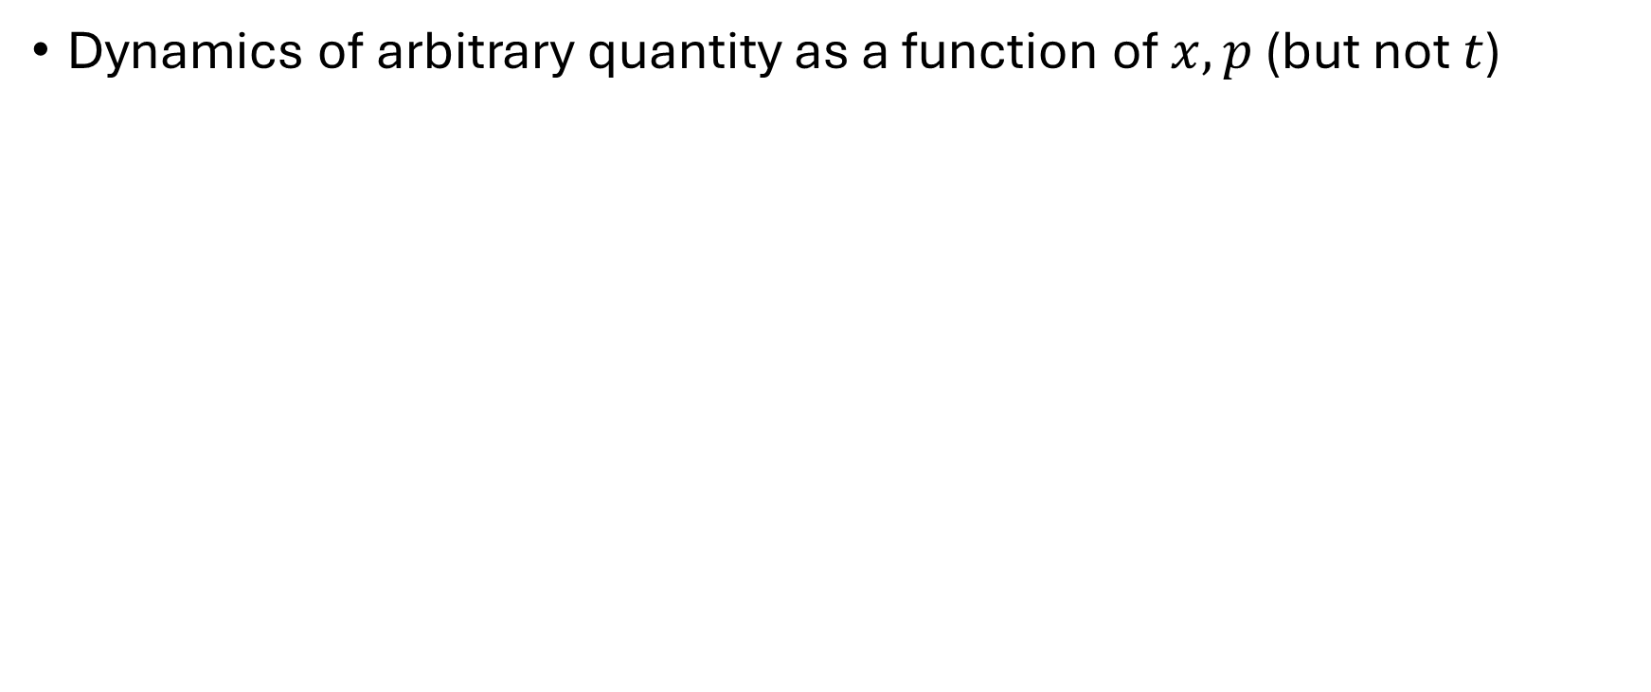
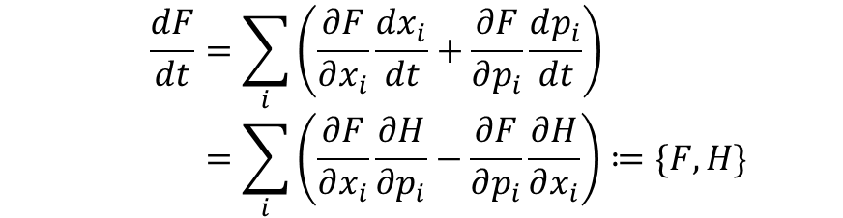
Poison Brackets
Dynamics of arbitrary quantity as a function of $x, p$ (but not $t$)
$$F(x,p)$$
$$\frac{dF}{dt}=\sum_{i}{\left(\frac{∂F}{∂x_{i}}\frac{dx_{i}}{dt}+\frac{∂F}{∂p_{i}}\frac{dp_{i}}{dt}\right)} \\ =\sum_{i}{\left(\frac{∂F}{∂x_{i}}\frac{∂H}{∂p_{i}}−\frac{∂F}{∂p_{i}}\frac{∂H}{∂x_{i}}\right)}≔\{F,H\}$$
Poison Brackets

Slide 8
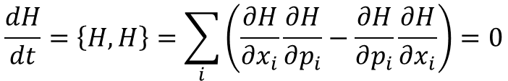
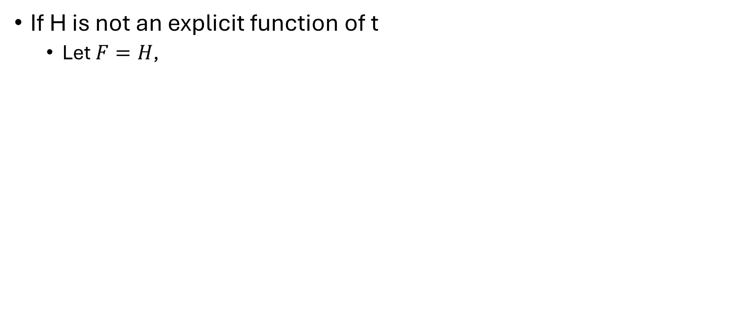
Energy
If H is not an explicit function of t
  Let $F=H$,
$$\frac{dH}{dt}=\left\{H,H\right\}=\sum_{i}{\left(\frac{∂H}{∂x_{i}}\frac{∂H}{∂p_{i}}−\frac{∂H}{∂p_{i}}\frac{∂H}{∂x_{i}}\right)=0}$$
$$H(x,p)=E$$

Slide 9
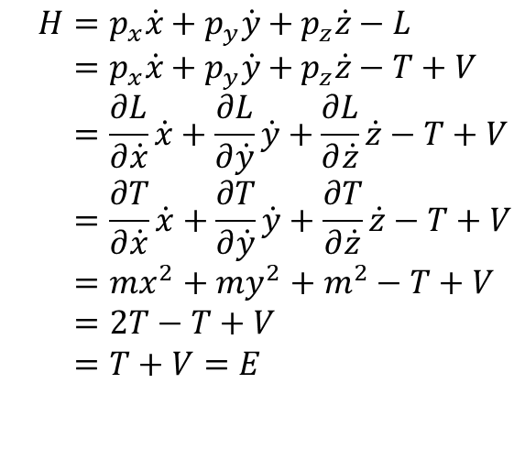

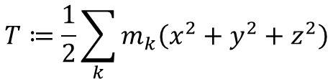
Example: Mechanical Energy
$$L=T−V$$
$$T≔\frac{1}{2}\sum_{k}{m_{k}\left(x^{2}+y^{2}+z^{2}\right)}$$
$$H=p_{x}\dot{x}+p_{y}\dot{y}+p_{z}\dot{z}−L \\ =p_{x}\dot{x}+p_{y}\dot{y}+p_{z}\dot{z}−T+V \\ =\frac{∂L}{∂\dot{x}}\dot{x}+\frac{∂L}{∂\dot{y}}\dot{y}+\frac{∂L}{∂\dot{z}}\dot{z}−T+V \\ =\frac{∂T}{∂\dot{x}}\dot{x}+\frac{∂T}{∂\dot{y}}\dot{y}+\frac{∂T}{∂\dot{z}}\dot{z}−T+V \\ =mx^{2}+my^{2}+m^{2}−T+V \\ =2T−T+V \\ =T+V=E$$

Slide 10
Linear and angular momentum

